Slide 1
Excel II - PivotTables
Management Information Systems
Disha Parkhi

Slide 2
Outline
PivotTables and PivotCharts
Appendix I: Functions that do the same job as PivotTables – SUMIF(S) and COUNTIF(S)
Appendix II: Freezing panes and printing
File: Sociology Books.xlsx

Slide 3
Pivot tables
And pivot charts
Books – pivotT.xlsx

Slide 4
The Sociology books
The file ‘Sociology Books.xlsx’ contains the current textbook offerings of the Sociology Division of a certain publisher.
Each textbook falls into a general discipline, and each discipline is divided into several areas.
The company tracks units sold, unit prices, and gross sales by two major types of sales: wholesale sales to bookstores and retail sales to individual consumers.

Slide 5
What is a PivotTable?
A tool that summarizes large amounts of data.
It allows you to aggregate data into one or more categories and perform a variety of calculations without altering the original data source.
It is dynamic: you can easily and quickly rearrange the data to see it from different angles, such as expanding or collapsing details, organizing and grouping data differently, and switching row and column categories.
This possibility of viewing data from different perspectives helps you more easily identify trends and patterns among the variables in the data that might not be obvious.
☞ If the data changes in the original source, we need to refresh the PivotTable so it reflects the most updated data.

Slide 6
PivotTables
We want to create the following table to analyze the books sales:
Pivot Table 1: A table that shows the total book sales by Copyright year.

Slide 7
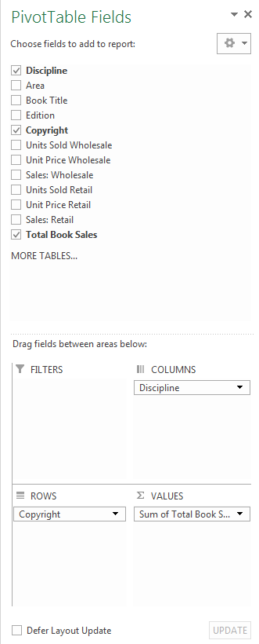
PivotTable
Filters the aggregated data to display results based on particular conditions you set.
Subdivides data into one or more additional categories to add depth to the PivotTable.
Organizes and groups data into categories on the left side of the PivotTable. Each group name occupies a single row.
Displays summary statistics, such as totals or averages.

Slide 8
PivotTables
Pivot table 2: shows the total book sales by Copyright year and by Discipline.
Pivot table 3: displays the number of books, the average and sum of total book sales per Area for each Copyright year.

Slide 9
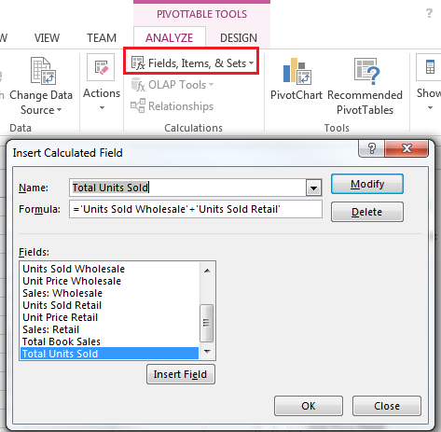
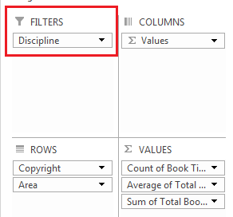
Calculated Fields
Still on Pivot Table 3:
Change the previous Pivot Table 1 so that it also shows the sum of total number of units sold in each year (we need to create a calculated field for this).
Add a filter to Pivot Table 3 that allows filtering by discipline.

Slide 10
More PivotTables
Pivot table 4: We want to know what is the contribution (in %) of each Discipline and more specifically of each Area to the sales grand total. What is the discipline that sold the most? What about the one that sold the least?
And the contribution of each book?

Slide 11
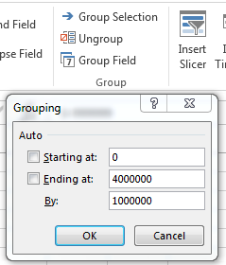
Grouping numeric fields in PivotTables
Pivot Table 5: we want to show the number of book titles that had a revenue between 0 and $99,999, between $100,000 and $199,000, and so on…

Slide 12
PivotCharts
PivotTables help reduce the amount of data to analyze, but they can be overwhelming. Creating a PivotChart aids people’s comprehension of the data.
Some PivotTables may have a lot of information, or may have information that is in different units / magnitudes. So, if we want to create PivotCharts using them, we need to be critical about the information and select what and how it makes sense to display in a chart.
We do not need to have a PivotTable to make a PivotChart, we can create a PivotChart directly from the source data and it will create the corresponding PivotTable.

Slide 13
PivotCharts
Pivot chart 1: Create a bar chart to show the number of units sold wholesale and the number of units sold retail for each Discipline.
Pivot chart 2: Create a pie chart that illustrates the % of the total units sold corresponding to each discipline.

Slide 14
Extracting Data from PivotTables
If you need to use specific data taken from a PivotTable somewhere else, you can use the GETPIVOTDATA function for that:
= GETPIVOTDATA (data_field, pivot_table, field1, item1, field2, item2, ...)
data_field is the name, enclosed in quotation marks, for the data field that contains the data that you want to retrieve.
pivot_table is a reference to any cell of the PivotTable (this is simply used to determine which PivotTable contains the data that you want).
field1, item1, field2, item2,… pairs of field names and item names that describe the data that you want to retrieve. Field names and names for items other than dates and numbers are enclosed in quotation marks.

Slide 15
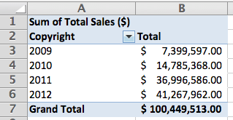
Extracting Data from PivotTables
If we want to use the value in cell B3 of the pivot table below:
=GETPIVOTDATA("Sum of Total Sales ($)",$A$1,"Copyright",2009)
Or
=GETPIVOTDATA("Sum of Total Sales ($)",$A$1,"Copyright",A3)

Slide 16
Appendix I
SUMIF(S) and COUNTIF(S)
Books – Appdx I.xlsx

Slide 17
SUMIF function
The SUMIF function combines the SUM and IF functions: it sums the values that meet a certain condition:
=SUMIF (range, criteria, [sum_range])
range is the range of cells to be evaluated with a criteria
criteria is a number, date or expression in quotation marks which determines whether a given cell in the sum range is considered in the sum, e.g. “=10”, “<=10”, “Full Time”, “>=1/1/2000”
☞ When, in criteria, we want to compare with the content of a cell we need to use & before the cell reference. E.g. if the criteria is “greater than the value in cell A2”, we write “>”&A2 (not “>A2” neither “>&A2”). If the criteria is “equal to the value of cell A2” we can write simply A2 or “=“&A2.
[sum_range] is the range of cells to be summed. It is optional, and when omitted it is assumed to be the same as range.

Slide 18
SUMIF and SUMIFS functions
When we have multiple criteria we can use:
=SUMIFS (sum_range, range1, criteria1, range2, criteria2,…)
Note that sum_range is now the first argument. All arguments work the same way as in SUMIF.
AVERAGEIF and AVERAGEIFS functions work the same way:
=AVERAGEIF (range, criteria, [average_range])
=AVERAGEIFS (average_range, range1, criteria1, range2, criteria2,…)

Slide 19
Counting functions
COUNTIF (range, criteria)
COUNTIFS (range1, criteria1, range2, criteria2,…)
These work just as SUMIF and SUMIFS do.
COUNT(range) counts the number of cells in a range containing numbers
COUNTA(range) counts the number of nonblank cells in a range
COUNTBLANK(range) counts the number of blank cells in a range

Slide 20
Using these functions….
(Similar to PivotTable 1): Create a table that shows the number of different books and the total book sales (revenue) by Copyright year.
(Same as PivotTable 5): Create a table that shows the number of book titles that had a revenue between 0 and $999,999, between $1,000,000 and $1,999,000, and so on…
(Same as PivotTable 2): shows the total book sales by Copyright year and by Discipline.

Slide 21
Appendix II
Freezing panes and printing Excel worksheets

Slide 22
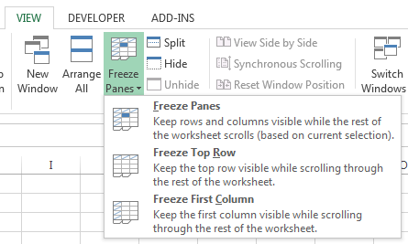
Freeze Panes
If you need Microsoft Excel to keep specific rows or columns visible when you scroll in the worksheet, you can use the Freeze Panes tool.
  To lock more than one row or column, or to lock both rows and columns at the same time, select the cell below the row(s) you want to freeze and to the right of any column(s) you want to freeze, and click Freeze Panes -> Freeze Panes.
  To lock multiple rows (starting with row 1), select the row below the last row you want frozen, and then click Freeze Panes -> Freeze Panes (similarly for columns).

Slide 23
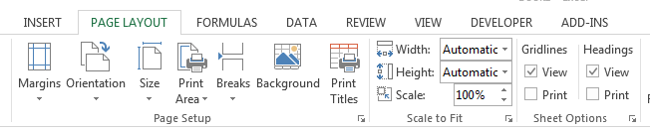
Printing Worksheets
  Explore the Page Layout menu to learn how you can print a good looking Excel spreadsheet.
  To see the effect of these definitions, go to File->Print where you will have a preview of the printed pages.
To print a certain area, select the area you want to print and click Print Area->Set print area
If the paper orientation is Portrait, to make sure the content all fits in one page and it is not split, select Width->1 page. If you chose Landscape, then you would do the same but with Height.
To print the gridlines or row/column headings, check the respective Print.

